Slide 1


A cross platform fleet management app offering a driver behavior tracking system
Supervisor: Dr.Islam Elsharawy CO-Supervisor: Dr.momen zaher
Ahmed Diaaeldin 210137

Slide 2

Introduction 1/2
The UN goals:
Climate action
decent work economic growth
professional drivers face with high risk of death in road traffic accidents, among which, 85% are caused by man-made errors
Similarly, Lynn and Lockwood (1999) pointed out in their research that considering the company's high mileage of car drivers, their accidents were 50% more often than that of ordinary drivers
https://www.researchgate.net/publication/221720836_Road_Traffic_Injuries_and_Data_Systems_in_Egypt_Addressing_the_Challenges#:~:text=Current%20estimates%20for%20Egypt%20show,DALYs)%20lost%20in%20the%20country.
https://www.autonews.com/mobility-report-newsletter/average-time-spent-us-traffic-jams-cut-73-hours-during-pandemic-study#:~:text=Traffic%20delays%20fell%20nearly%2050,been%20wasted%20sitting%20in%20traffic.

Slide 3
Motivation:
Enhance Work Safety: Initiatives to reduce accidents aim to foster a safer working environment for drivers, ensuring their well-being and security.
Boost Economic Efficiency: Minimizing road accidents curtails related economic losses, improving productivity and reducing expenses in healthcare and vehicle maintenance.
Enhance Work Safety: Initiatives to reduce accidents aim to foster a safer working environment for drivers, ensuring their well-being and security.
Boost Economic Efficiency: Minimizing road accidents curtails related economic losses, improving productivity and reducing expenses in healthcare and vehicle maintenance.
Promote Decent Work: Implementing measures that lead to a reduction in accidents will contribute to creating a safer and more secure working environment for professional drivers.
Support Economic Growth: By decreasing the number of accidents, the project aims to reduce the economic losses associated with road traffic accidents, such as costs related to health care, vehicle repairs, and lost productivity due to road closures and traffic jams.

Slide 4
Technical Problem
System high accuracy detection of dangerous driver behavior required human observation and report.
But the detection of :
Driver dangers patterns
The outer circumstances
Will indeed lower the human need.
A lot of research on understanding ML algorithms, there's little on how to set them up properly
Will You Accept an Imperfect AI? Exploring Designs for Adjusting End-user Expectations of AI Systems. In Proceedings of the 2019 CHI Conference on Human Factors in Computing Systems (CHI '19). Association for Computing Machinery, New York, NY, USA, Paper 411, 1–14. https://doi.org/10.1145/3290605.3300641
Notes:
(hard coded checking had no confidence)

Slide 5
Objectives
Driver aggressive driving detection:
speeding and braking (in context)
Harsh/Sudden Turns
Continuous Lan change
Rapidly bring trained models into production
Continuous evaluation
Incremental training
D. Kreuzberger, N. Kühl and S. Hirschl, "Machine Learning Operations (MLOps): Overview, Definition, and Architecture," in IEEE Access, vol. 11, pp. 31866-31879, 2023, doi: 10.1109/ACCESS.2023.3262138.
Notes:
harsh speeding and braking Must be in context, speed in a turn or turn, speed in a busy road

Slide 6
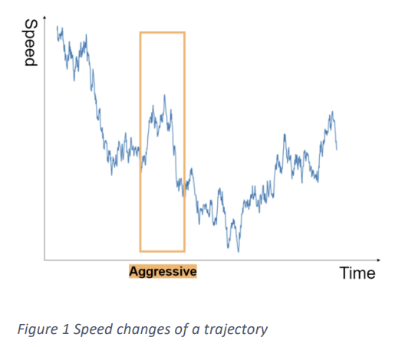
Related work 1/2 : Driving Behavior Classification Based on Oversampled Signals of Smartphone Embedded Sensors Using an Optimized Stacked-LSTM Neural Networks
This study proposes a model that can discover the aggressive driving pattern in less than 3 minutes
UAH-DriveSet, performing 3 different behaviors
99.6 percent in three minutes of driving , 93 percent accuracy in real-world testing
V. S. Padilla, A. Collaguazo, J. J. Cabrera and J. Pesantez, "M2M technology for bus fleet management. Case study: A college transportation system," 2020 IEEE Technology & Engineering Management Conference (TEMSCON), Novi, MI, USA, 2020, pp. 1-5, doi: 10.1109/TEMSCON47658.2020.9140131.
Notes:
PATTERN OF DRIVER SPEED BRACKING TUING classify aggressive or non-aggressive driving behaviour. GAU is just like LSTM but req. less parameters

Slide 7
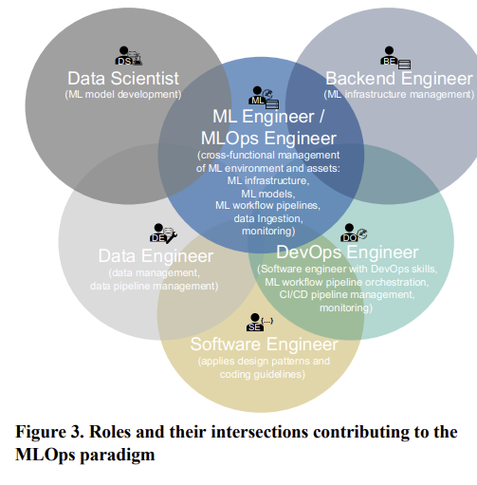
Related work 2/2 : Machine Learning Operations (MLOps): Overview, Definition, and Architecture
MLOps Definition & Architecture: The study provides a comprehensive definition of MLOps, highlighting its essential role in transitioning ML models from development to scalable, sustainable production environments.
Methodology: Utilizes a mixed-method approach to establish core principles, components, necessary roles, and workflow orchestration for effective ML operations.
D. Kreuzberger, N. Kühl and S. Hirschl, "Machine Learning Operations (MLOps): Overview, Definition, and Architecture," in IEEE Access, vol. 11, pp. 31866-31879, 2023, doi: 10.1109/ACCESS.2023.3262138.

Slide 8
Problem statement
A cross platform fleet management app: offering:
1-a driver behavior real time tracking
2- always in production

Slide 9
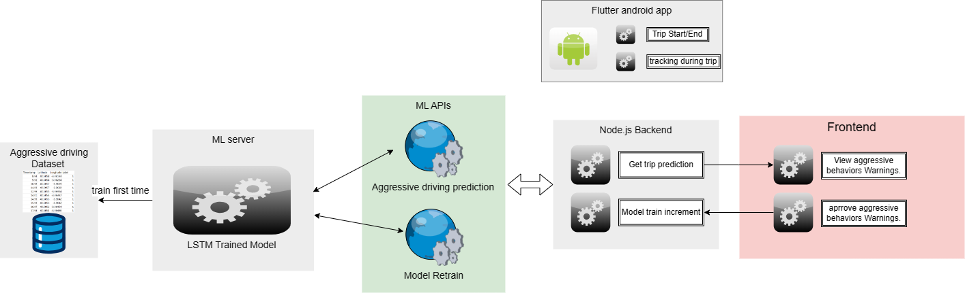
Proposed Solution:

Slide 10
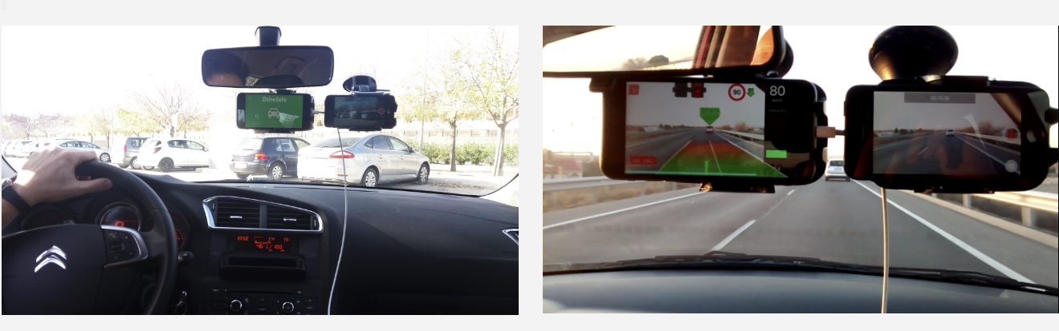
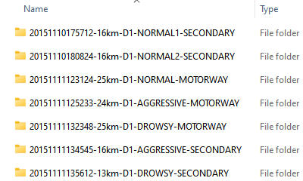
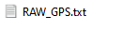
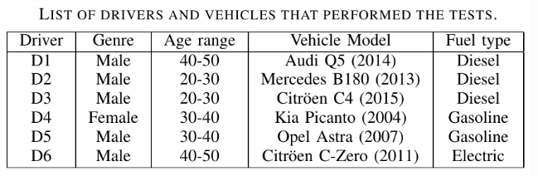
Dataset: UAH-DriveSet
captured by our driving monitoring app DriveSafe
rates each trip within 3 behavior models
( normal, drowsy (distracted) and aggressive )
E. Romera, L.M. Bergasa and R. Arroyo, "Need Data for Driving Behavior Analysis? Presenting the Public UAH-DriveSet", IEEE International Conference on Intelligent Transportation Systems (ITSC), pp. 387-392, Rio de Janeiro (Brazil), November 2016. [pdf]
Notes:
MOTORWAY UP TO 90KM

Slide 11
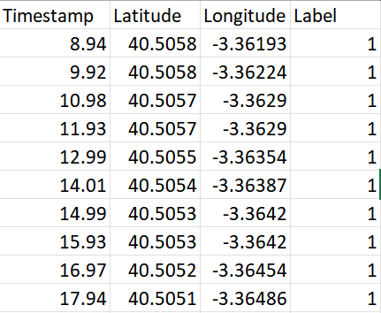
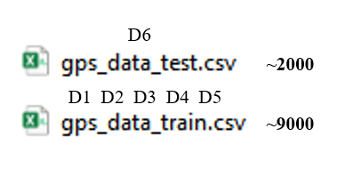

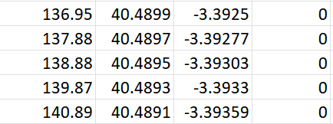
Dataset: UAH-DriveSet
rates each trip within 3 behavior models
( normal, drowsy (distracted) and aggressive )
0 1
E. Romera, L.M. Bergasa and R. Arroyo, "Need Data for Driving Behavior Analysis? Presenting the Public UAH-DriveSet", IEEE International Conference on Intelligent Transportation Systems (ITSC), pp. 387-392, Rio de Janeiro (Brazil), November 2016. [pdf]
Notes:
MOTORWAY UP TO 90KM

Slide 12
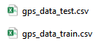
Dataset: UAH-DriveSet
rates each trip within 3 behavior models
( normal, drowsy (distracted) and aggressive )
0 1
D6
~2000
D1 D2 D3 D4 D5
~9000
E. Romera, L.M. Bergasa and R. Arroyo, "Need Data for Driving Behavior Analysis? Presenting the Public UAH-DriveSet", IEEE International Conference on Intelligent Transportation Systems (ITSC), pp. 387-392, Rio de Janeiro (Brazil), November 2016. [pdf]
Notes:
MOTORWAY UP TO 90KM

Slide 13
Algorithm:
Before feeding to the algorithm, Data preprocessing :
Split each trip and make then independent.
The time difference rather than stamps
Long and late were normalized
Training :
Each trip was fed into the model separately.
E. Romera, L.M. Bergasa and R. Arroyo, "Need Data for Driving Behavior Analysis? Presenting the Public UAH-DriveSet", IEEE International Conference on Intelligent Transportation Systems (ITSC), pp. 387-392, Rio de Janeiro (Brazil), November 2016. [pdf]

Slide 14
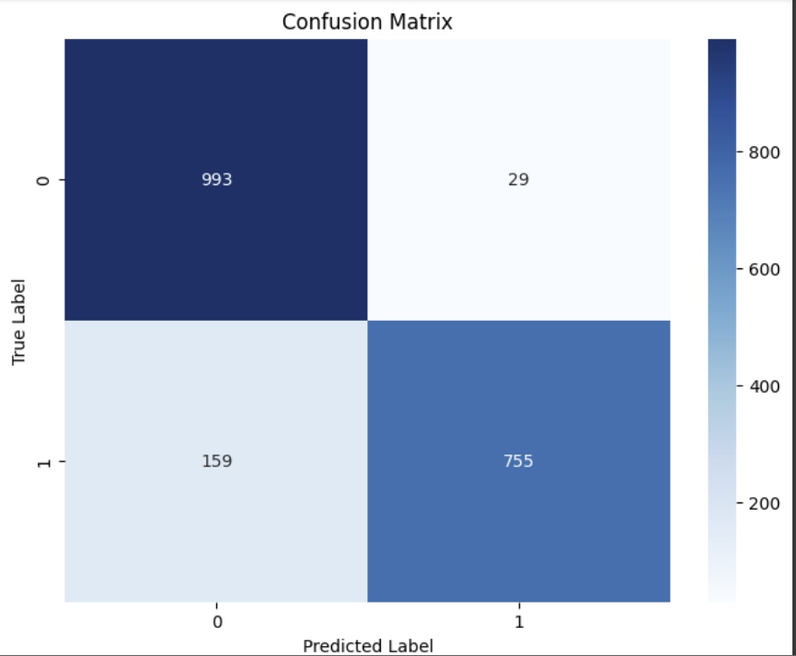
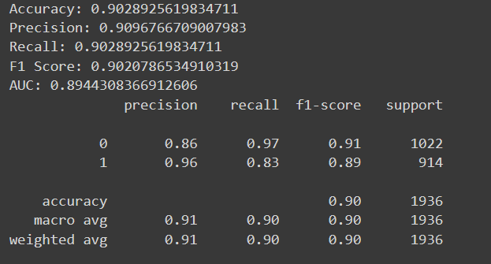
Algorithm:
Results on test data:
E. Romera, L.M. Bergasa and R. Arroyo, "Need Data for Driving Behavior Analysis? Presenting the Public UAH-DriveSet", IEEE International Conference on Intelligent Transportation Systems (ITSC), pp. 387-392, Rio de Janeiro (Brazil), November 2016. [pdf]

Slide 15
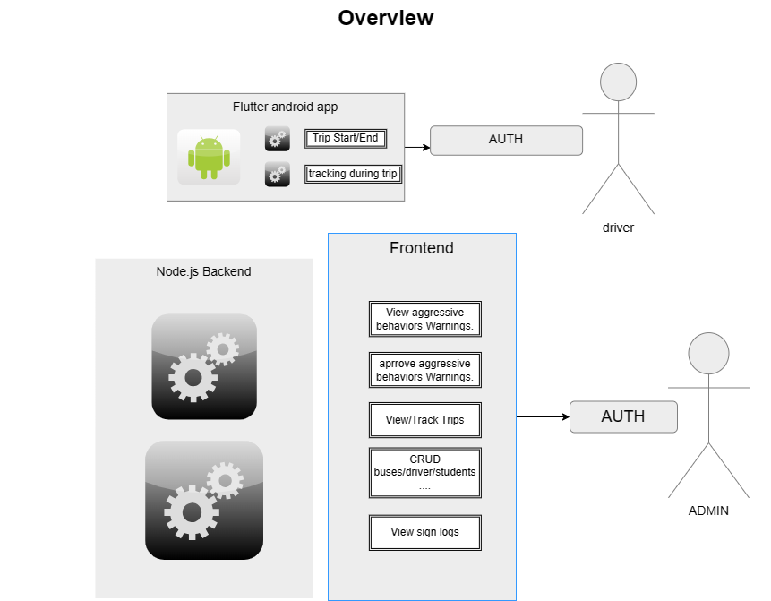
System Overview:

Slide 16
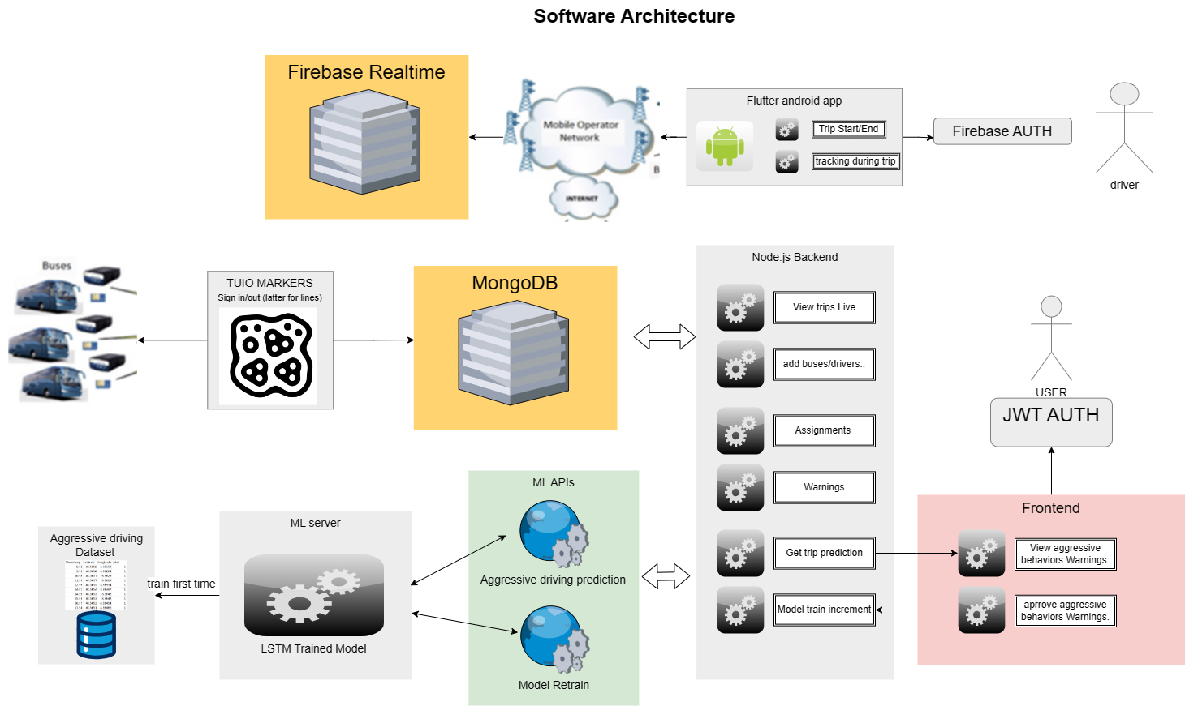
System Architecture:

Slide 17
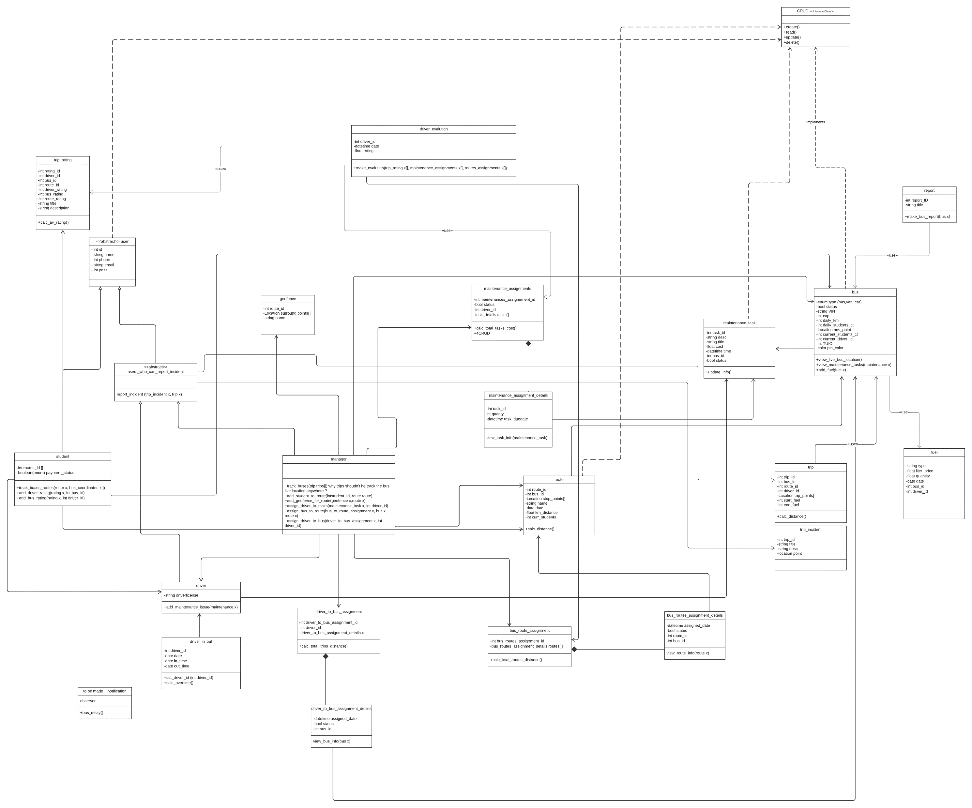

Slide 18
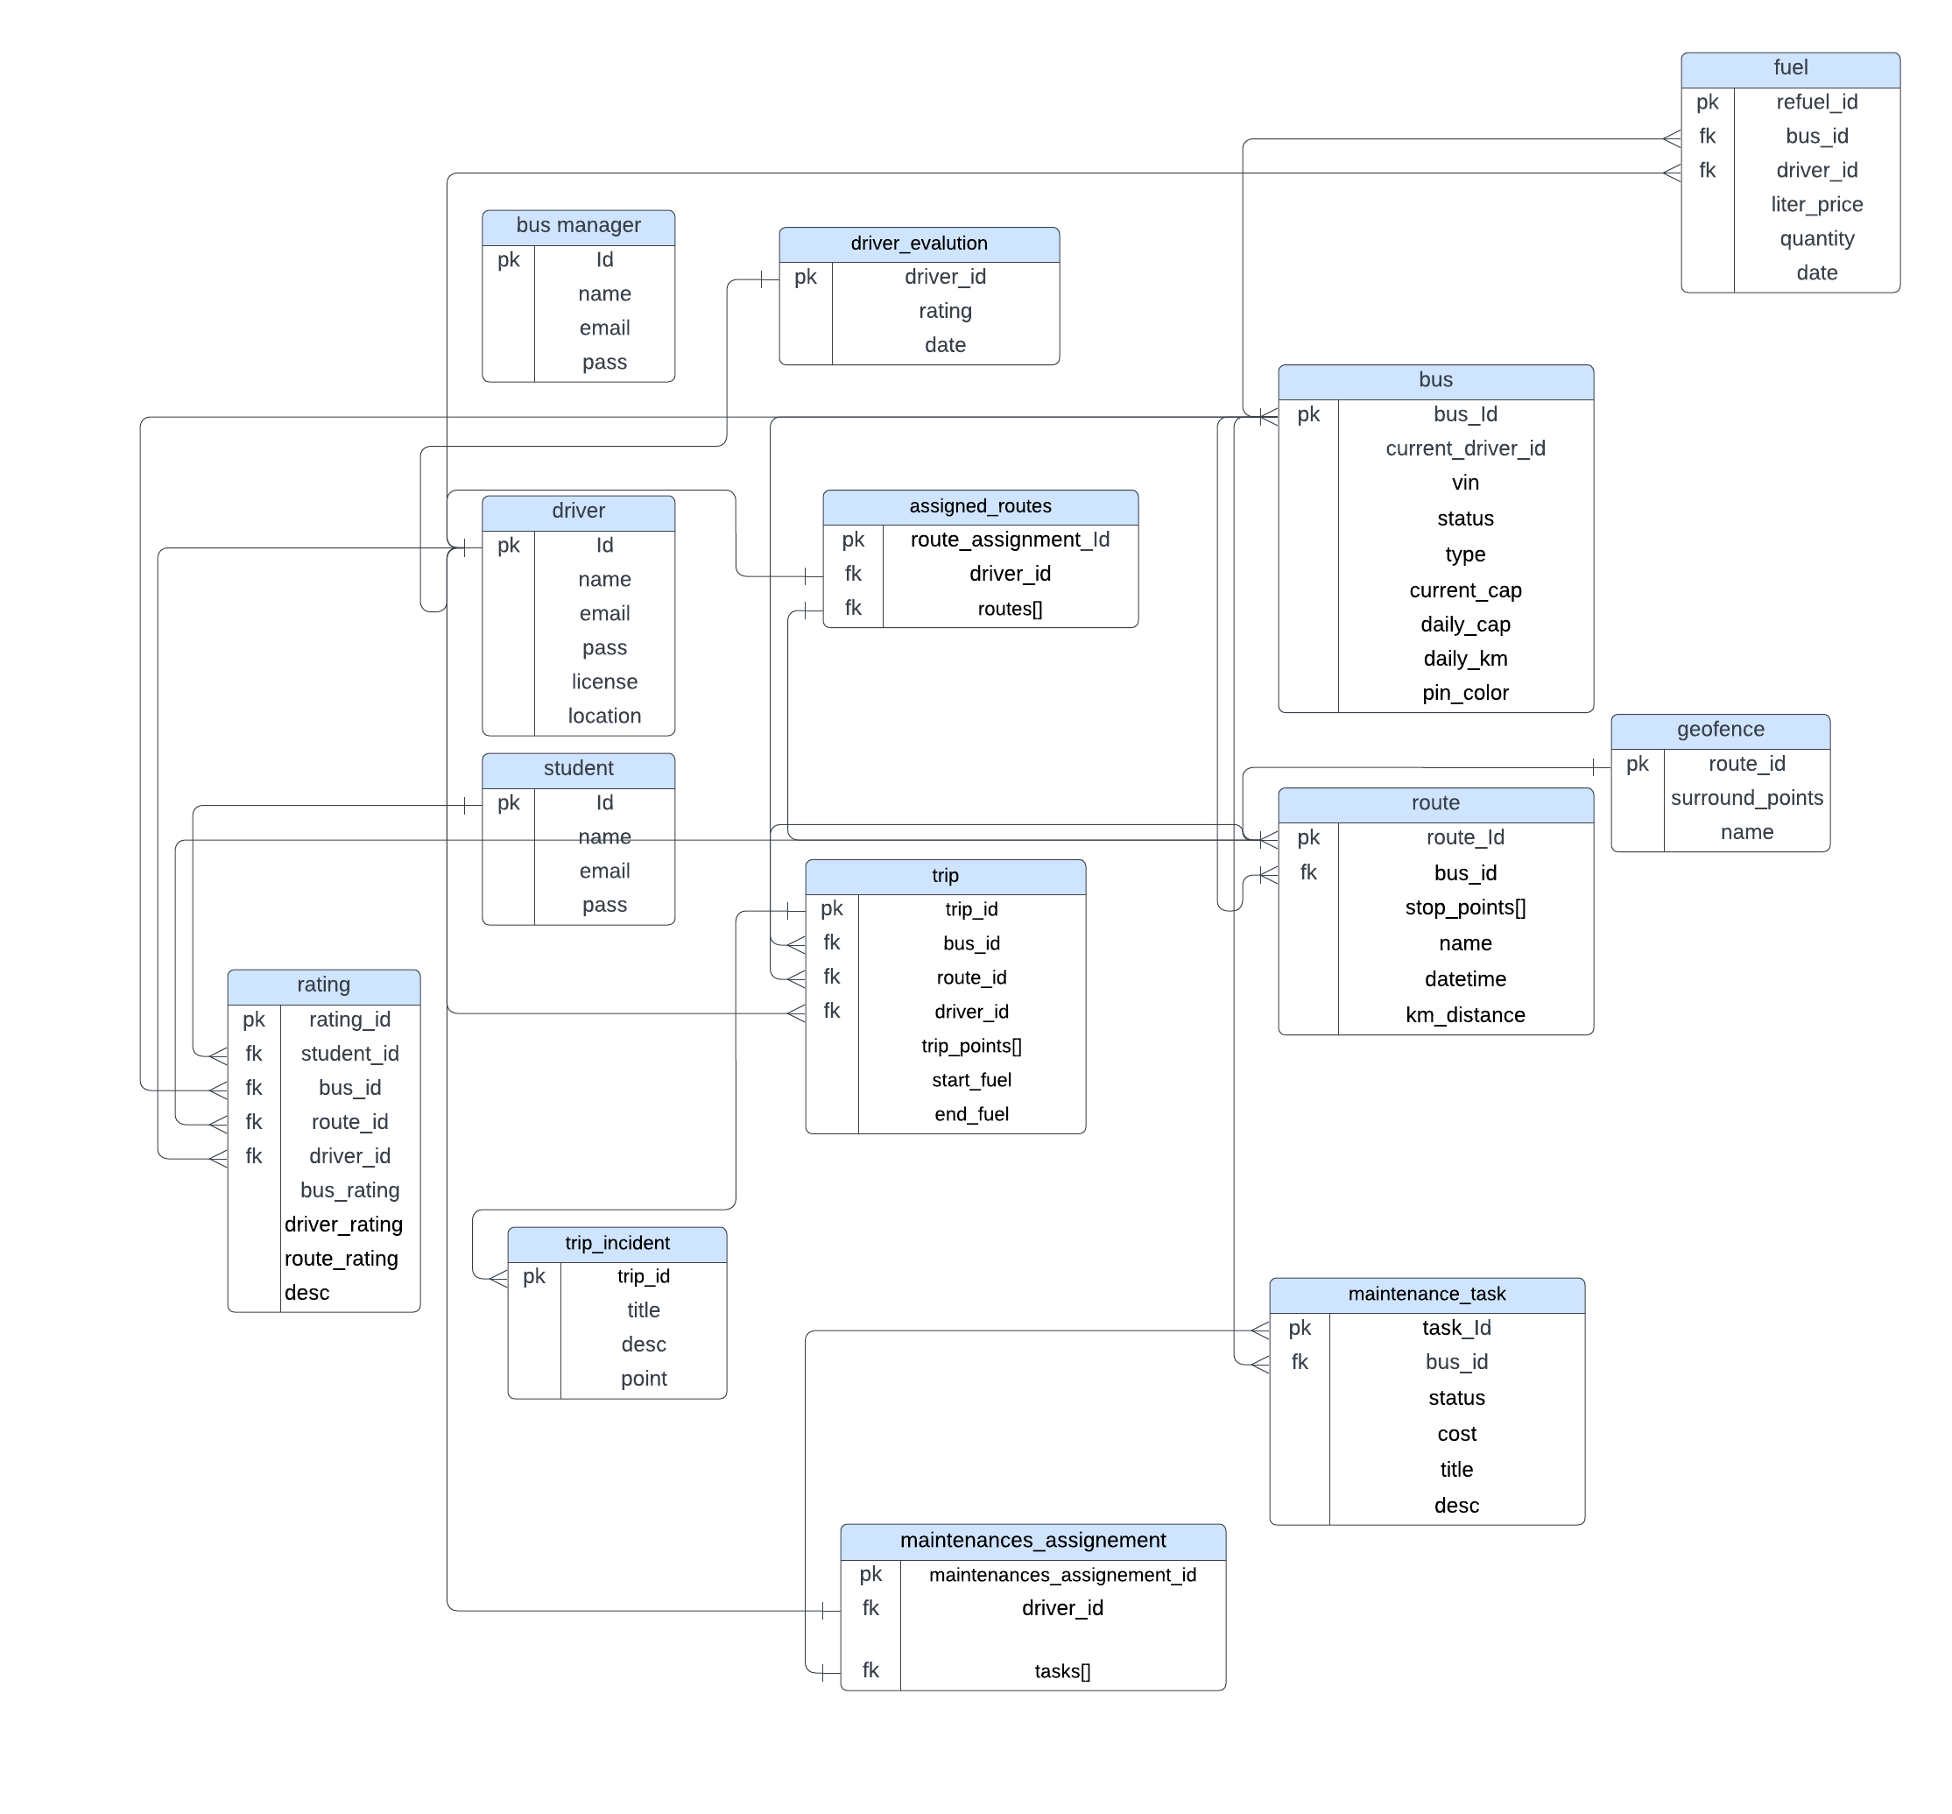

Slide 19
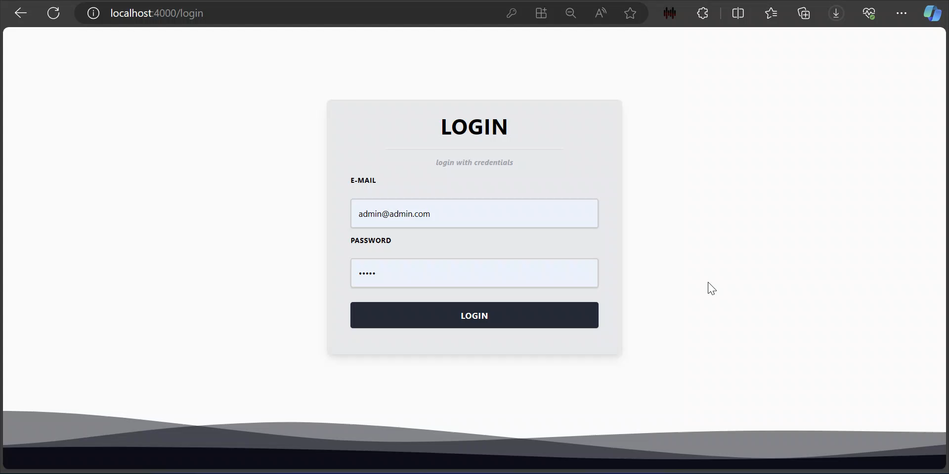
Demo website & markers:

Slide 20
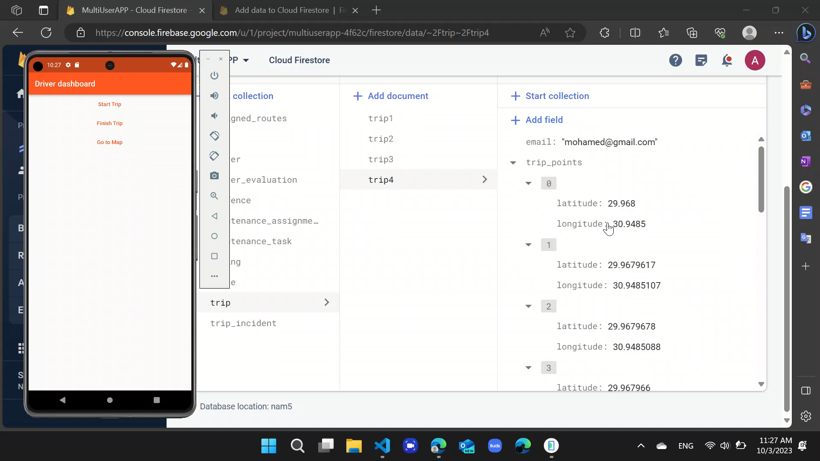

Slide 21
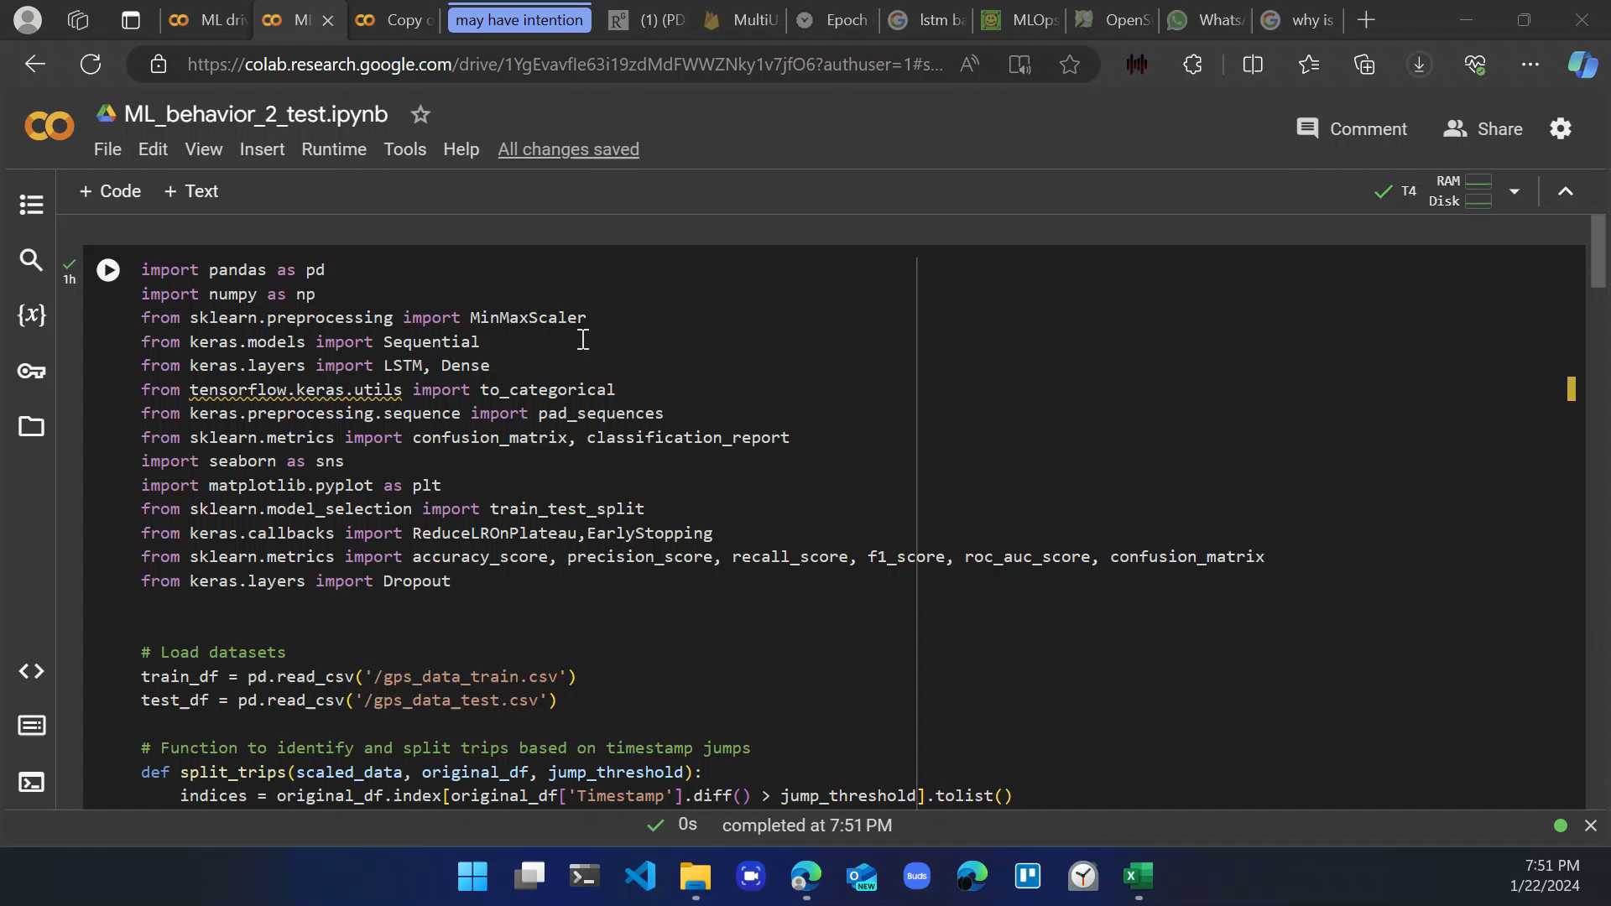

Slide 22
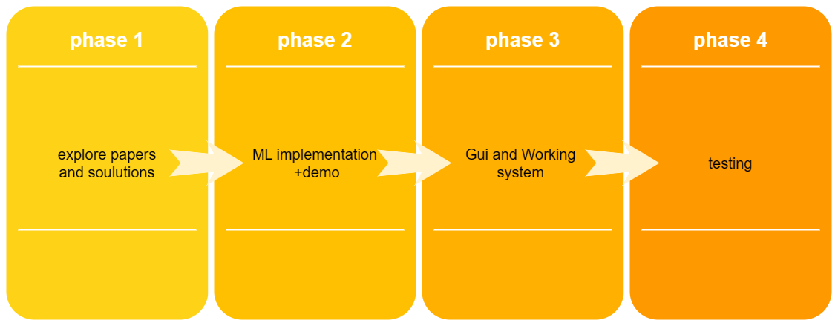

Slide 23
References
D. Kreuzberger, N. Kühl and S. Hirschl, "Machine Learning Operations (MLOps): Overview, Definition, and Architecture," in IEEE Access, vol. 11, pp. 31866-31879, 2023, doi: 10.1109/ACCESS.2023.3262138.
V. S. Padilla, A. Collaguazo, J. J. Cabrera and J. Pesantez, "M2M technology for bus fleet management. Case study: A college transportation system," 2020 IEEE Technology & Engineering Management Conference (TEMSCON), Novi, MI, USA, 2020, pp. 1-5, doi: 10.1109/TEMSCON47658.2020.9140131.
Zhao, Dengfeng, Haiyang Li, Junjian Hou, Pengliang Gong, Yudong Zhong, Wenbin He, and Zhijun Fu. 2023. "A Review of the Data-Driven Prediction Method of Vehicle Fuel Consumption" Energies 16, no. 14: 5258. https://doi.org/10.3390/en16145258
https://www.researchgate.net/publication/221720836_Road_Traffic_Injuries_and_Data_Systems_in_Egypt_Addressing_the_Challenges#:~:text=Current%20estimates%20for%20Egypt%20show,DALYs)%20lost%20in%20the%20country.
https://www.autonews.com/mobility-report-newsletter/average-time-spent-us-traffic-jams-cut-73-hours-during-pandemic-study#:~:text=Traffic%20delays%20fell%20nearly%2050,been%20wasted%20sitting%20in%20traffic.
Wanli Han, Jianyou Zhao,Driver behaviour and traffic accident involvement among professional urban bus drivers in China,Transportation Research Part F: Traffic Psychology and Behaviour,Volume 74,2020,Pages 184-197,ISSN 1369-8478,https://doi.org/10.1016/j.trf.2020.08.007.(https://www.sciencedirect.com/science/article/pii/S1369847820304897)
D. Kreuzberger, N. Kühl and S. Hirschl, "Machine Learning Operations (MLOps): Overview, Definition, and Architecture," in IEEE Access, vol. 11, pp. 31866-31879, 2023, doi: 10.1109/ACCESS.2023.3262138.

